Slide 1
Investigations in Male
SIG Endocrinology 2019
Chairperson – Madhuri Patil

Slide 2
Semen Analysis will provide the direction for further evaluation and treatment
Azoospermia
Semen Analysis
Normal
No Therapy Needed
Treatable Disorder
Non treatable fertility disorder
Adoption
Donor insemination
Rational Therapy
Optimization of female reproductive function
Assisted Reproductive Technology

Slide 3
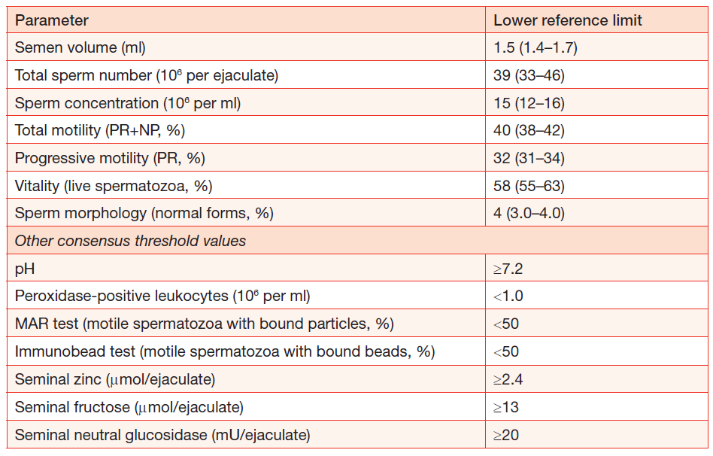
WHO criteria – 2010

Slide 4
Abnormal Semen Parameters
Medical and Sexual history
Physical Examination
Ultrasound
Endocrine Evaluation – FSH, LH, Testosterone, E2, SHBG, TSH, Prolactin
Karyotyping
Molecular genetics - Y-chromosome microdeletion and Cystic Fibrosis Gene mutations
Sperm function test
Testicular Biopsy
Post ejaculation urine examination

Slide 5
Sperm Function Test
HOS
Detailed sperm morphology, including TZI
Trial Wash to determine quantitative & qualitative yields with sperm survival
Anti-Sperm Antibodies
Computer-Aided Sperm Analysis (CASA)
Mucus penetration - capable sperm population in semen
Sperm DNA fragmentation
ROS - Lipid peroxidation can affect fertility
Acrosome reaction ; Acrosin activity test
Biochemical test – Creatine Kinase

Slide 6
Indications for Sperm DNA Testing
The test should be offered before IVF/ICSI to male partners of couples with a history of:
Unexplained or persistent infertility
Failure to conceive after 5- 6 IUI cycles despite good count and motility
Low fertilization rates or poor embryo quality in IVF cycles
Implantation failure after IVF
Recurrent miscarriage
Prolonged stay in an environment that exposes to reproductive toxins
Abnormal semen Analysis
Advancing male age (> 45 years)

Slide 7
Detection of sperm DNA damage

Slide 8
Analysis of Results
DNA Fragmentation Index (DFI)
0-15% high fertility potential
> 15% and < 30% good to fair fertility potential
30% and higher low to poor fertility potential

Slide 9
However other test though useful to indicate chances of failure but not regularly performed prior to ART treatment because
Cannot be performed with good repeatability and reliability and at minimal cost
NNT 100
Cost > Rs 50000/-

Slide 10
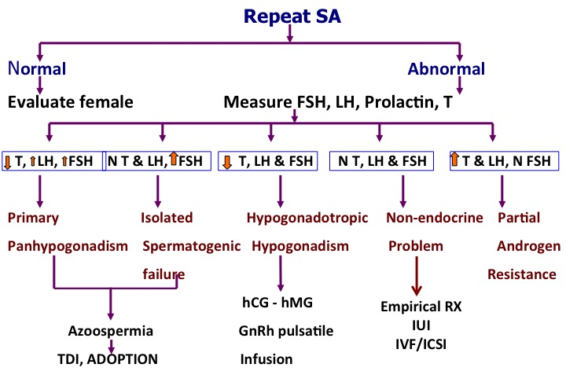
Diagnostic and Therapeutic Algorithm for abnormal Sperm Parameters
No Rx
TDI
Adoption

Slide 11
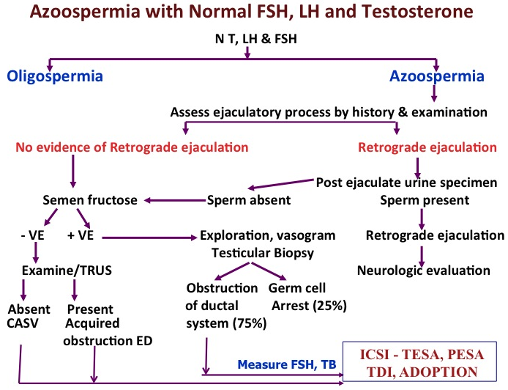
IUI/ART

Slide 12
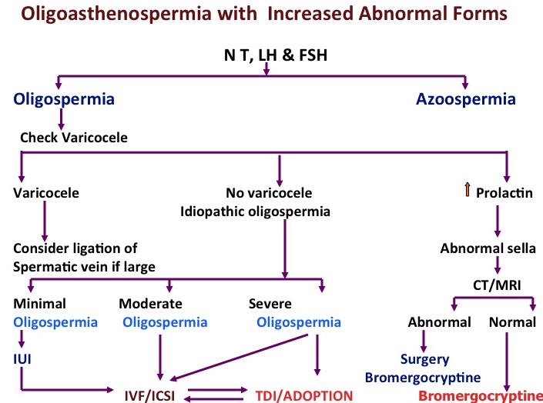

Slide 13
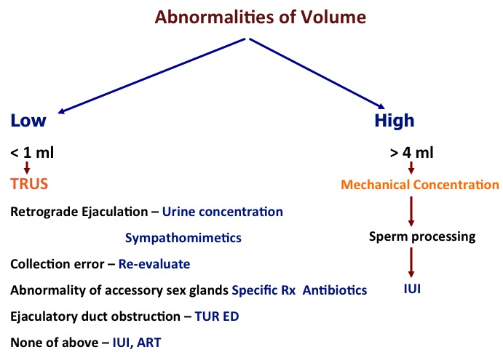

Slide 14
Abnormalities of Viscosity
Hyperviscous
Sperm Washing/processing
IUI

Slide 15
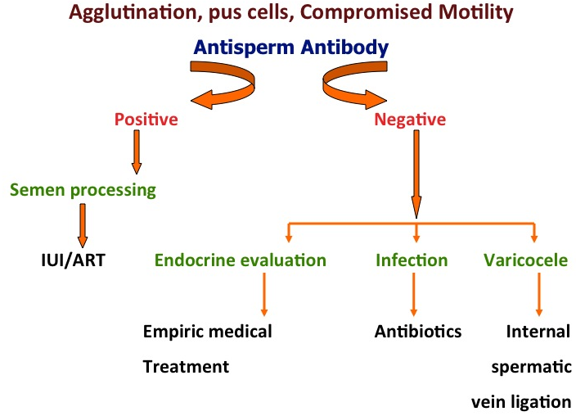

Slide 16
Take Home Message
Conventional semen analysis does not provide precise information on the fertility potential of male subjects:
normal semen analysis may not reflect defects in sperm function
spontaneous pregnancy can still occur despite abnormal sperm parameters
There is no agreement on the definition of normal semen parameters as they are being constantly revised in the light of the new study results
WHO parameters for SA are not sufficient to interpret the fertility status or chance of pregnancy in either natural or assisted conception

Slide 17
Take home messages
The use of sperm function tests is recommended to refine the diagnosis, mainly when in vitro fertilization is indicated and no clear cause of the infertility has been found
Sperm function test may be useful for identifying a MF contributing to UI or for selecting therapy- but for whom and which one(s) is unclear at present
There is a need for accurate, cost effective & targeted sperm function testing

